Slide 1



UE21CS390A – CAPSTONE PROJECT REVIEW #2
(Project Requirements Specification and Literature Survey)
Project Title : Detection of Euphemism using BERT Model
Project ID : 66
Project Guide: Dr. Kamatchi Priya L

Slide 2





MEET THE TEAM
Chethan V
Janav Shetty
Remy Marsh
Harshini
Murugan
Darshan G N
PES2UG21CS143
PES2UG21CS151
PES2UG21CS210
PES2UG21CS193

Slide 3

CONTENT
01
ABSTRACT
02
MOTIVATION AND SCOPE OF PROJECT
03
SUGGESTIONS FROM REVIEW – 1
04
FUNCTIONAL AND NON - FUNCTIONAL REQUIREMENTS
05
LITERATURE SURVEY
06
CAPSTONE (PHASE-I & PHASE-II) PROJECT TIMELINE
07
CONCLUSION
08
REFERENCES

Slide 4
ABSTRACT
Toxic behavior in online communication is a pressing issue, exacerbated by the use of euphemistic language to mask harmful content.
The research project, "Detection of Online Toxic Euphemism using BERT Model," aims to develop computational solutions for automated detection of euphemistic language.
Leveraging advanced NLP techniques, particularly BERT, the project seeks to accurately identify and categorize toxic euphemisms.
Objectives include training the BERT model, developing real-time detection systems, implementing user-friendly interfaces, and evaluating performance metrics.
Aimed at fostering a safer online environment, the project acknowledges challenges such as language biases and the need for continuous adaptation, while striving to advance the field of online toxicity detection.

Slide 5

MOTIVATION AND SCOPE
Addressing Social Media Toxicity
Protecting User Well-being
Enhancing Platform Moderation
Empowering Users
Supporting Research and Development
Encouraging Positive Online Behavior

Slide 6
SUGGESTIONS FROM REVIEW-1
Answers to Questions from review 1
How long will the input be?
Textual data- 15 words(recommended)
Audio data- 10 seconds(recommended)
2. Change the problem statement.
We have taken the suggestion into consideration and changed our problem statement from “Real-Time Identification and Addressing of Hateful
Content in Online Conversations” to “Detection of Euphemism using BERT Model”

Slide 7

USER CLASSES AND CHARACTERISTICS
General users:
- Average Social Media Users
- Social Media Moderators
- Content Creators and Influencers
- Parents and Guardians
Content Moderators/Analysts: This user class utilizes the pre-built model to identify euphemisms within content that needs moderation. They may work on social media platforms, online forums, or other places where inappropriate language might appear.
Application Developers: This user class comes into play if the euphemism detection model is incorporated into a larger application. The system can be integrated into other social media platforms and used for content moderation.

Slide 8
GENERAL CONSTRAINTS
Language Diversity: Multiple languages and dialects require adaptable systems for accurate toxicity detection.
Contextual Understanding: Nuanced context makes accurate detection challenging.
Algorithm Biases: Biases in models necessitate careful preprocessing and evaluation.
Privacy Concerns: Analyzing user data raises privacy issues, demanding stringent privacy measures.
Resource Limitations: Real-time detection needs efficient algorithms to conserve resources.

Slide 9
DEPENDENCIES
Standardized Data Format: Input data will be consistently formatted for analysis.
Access to Training Data: Availability of diverse, labeled datasets for model training.
Internet Connectivity: Users have reliable internet access for using the web application.
User Engagement: Users will actively use the tool and provide feedback.
Regulatory Compliance: Adherence to legal regulations regarding data privacy and protection.

Slide 10
RISKS
Model Bias: Risk of biased models leading to unfair or inaccurate toxicity detection.
False Positives/Negatives: Risk of over-filtering non-toxic content or missing toxic content.
Adversarial Attacks: Risk of malicious users evading detection systems.
Privacy Breaches: Risk of exposing sensitive user data during analysis.
System Downtime: Risk of disruptions impacting platform availability.
Legal/Ethical Concerns: Risk of legal liabilities and ethical implications.

Slide 11
FUNCTIONAL REQUIREMENTS
Data Input:
The system should be able to accept text data in various formats like text and audio.
Preprocessing functionalities should be implemented to clean and prepare the text data (that is, tokenization, removal of punctuation, normalization).
BERT Model:
The system should utilize a pre-trained BERT model for euphemism detection.
Fine-tuning of the chosen BERT model on a labeled euphemism dataset is required.

Slide 12
FUNCTIONAL REQUIREMENTS
Euphemism Detection:
The system should be able to identify euphemisms within the processed input data.
Model Output:
The system should provide clear output indicating euphemism detection within the text data.
This can include highlighting euphemistic words/phrases or providing a classification label or flag.

Slide 13
NON-FUNCTIONAL REQUIREMENTS
Reliability
Scalability
Usability
Performance
Maintainability
Portability
Security

Slide 14
LITERATURE SURVEY
Paper Details | Objectives of paper Techniques/methods | Advantages | Limitations
 |  |  | Euphemism identification is inherently challenging due to the ambiguity and variability in language usage, which can limit the accuracy of automated systems. Requires domain specific training
The paper introduces a novel approach to euphemism detection and identification by leveraging self-supervised learning techniques and masked language models.
The model is tested on datasets of different domains and results show that the proposed approach outperforms several baseline methods.
The paper aims to generalize and extend the idea of self-supervision to the task of euphemism detection and identification.
Euphemism detection is done using MLM
Euphemism identification is done using coarse classifier and multi-class classifier
Self-Supervised Euphemism Detection and
Identification for Content Moderation

Slide 15
LITERATURE SURVEY
Paper Details | Objectives of paper Techniques/methods | Advantages | Limitations
This paper deals with sentiment analysis and toxicity measurements on social media opinions.
Classification methods like KNN, NBC, SVM, DT for sentiment analysis.
Positive and negative opinion results on digital bounty posts.
Most comments in the dataset scored 0 - 0.4 in toxicity.
Identifying sentiment and toxicity levels on social media posts.
Using classification methods like KNN, NBC, SVM, and DT.
Word cloud analysis for trend identification in social media datasets
Limited dataset size for sentiment analysis and toxicity measurements.
Word cloud analysis may not capture all relevant sentiments.
Toxicity and Sentiment Analysis About Digital Bounty on Social Media

Slide 16
LITERATURE SURVEY
Paper Details | Objectives of paper Techniques/methods | Advantages | Limitations
A Neuro-NLP Induced Deep Learning Model Developed Towards Comment Based Toxicity Prediction | Built three toxicity detection models using deep learning techniques. Utilized Receiver Operating Characteristic (ROC) and Area under the curve (AUC) graphs. Models compared for accuracy and results in comment toxicity detection. | Multi-headed models enhance comment toxicity detection accuracy. User-friendly interface for non-programmers to access toxicity detection models. Enhances user experience by providing multi-labeled output for understanding behavior. | Lack of practical implementation steps for toxicity detection models. Insufficient focus on user experience and interface design.

Slide 17
LITERATURE SURVEY
Paper Details | Objectives of paper Techniques/methods | Advantages | Limitations
Challenges for Toxic Comment Classification: An In-Depth Error Analysis | Compares deep learning and shallow approaches on a new dataset. Proposes an ensemble model that outperforms individual models. Validates findings on a second dataset for extensive error analysis. |  | Missing paradigmatic context and inconsistent dataset labels Inability to recognize multi-word phrases as single hateful phrases Out-of-vocabulary words like slang or intentionally obfuscated content Long-range dependencies affecting toxicity assessment in longer comments
Identifies challenges in toxic comment classification for future research.
Highlights missing paradigmatic context and inconsistent dataset labels.

Slide 18
LITERATURE SURVEY
Paper Details | Objectives of paper Techniques/methods | Advantages | Limitations
Classification of Toxicity in Comments using NLP and LSTM | Natural Language Processing approach for toxicity classification. Utilization of LSTM and GRU models for data analysis. LSTM model achieved 94% accuracy in predicting toxicity class. GRU model obtained an accuracy of 92% in toxicity prediction. | NLP and LSTM used for toxicity classification in comments. Data cleansing, EDA, and preprocessing techniques enhance model accuracy. NLP aids in classifying toxicity types in comments effectively. | No specific mention of limitations in the provided contexts.

Slide 19
LITERATURE SURVEY
Paper Details | Objectives of paper Techniques/methods | Advantages | Limitations
Toxic Language Detection in Social Media for Brazilian Portuguese :New Dataset and Multilingual Analysis | Focus on detecting toxic comments in Brazilian Portuguese social media. Introduced a new dataset for Brazilian Portuguese with toxic comments. Used BERT models achieving 76% macro-F1 score in binary case. Emphasized the need for large-scale monolingual data for accurate models. Highlighted challenges in classifying different types of toxic comments. | Enhances toxic comment detection in Brazilian Portuguese social media. Highlights the importance of collecting diverse examples for classification. | Difficulty in classifying certain types of toxic comments. Need for models aware of different categories of toxicity.

Slide 20
LITERATURE SURVEY
Paper Details | Objectives of paper Techniques/methods | Advantages | Limitations
Toxicity Detection: Does Context Really Matter? | Investigated impact of context on toxicity perception and classification. Used Wikipedia conversations with limited context: previous post and title. Experimented with toxicity labels changing without context provided to annotators. Tried various classifiers and mechanisms to make classifiers context-aware. | Examines context's influence on human judgment and toxicity detection. Demonstrates how context can amplify or mitigate toxicity perception, highlighting its importance. Uncovers label inconsistencies without context, urging for context-aware annotation. | No evidence that context improves toxicity classifier performance. Need for larger datasets of comments annotated in context. Narrow contextual context used in experiments Randomly sampled comments may not represent all conversational tones.

Slide 21
LITERATURE SURVEY
Paper Details | Objectives of paper Techniques/methods | Advantages | Limitations
Towards Robust Toxic Content Classification | Generating realistic model-agnostic attacks using a lexicon of toxic tokens[1] Training on synthetically noised data and proposing Contextual Denoising Autoencoder |  | Insufficient focus on specific types of toxic content. Limited exploration of the impact of noise on model performance.
Identifies vulnerabilities with toxic token lexicons.
Proposes training on noised data and using CDAE for robustness.
Offers practical tips for enhancing toxicity detectors.
Encourages the development of robust classifiers to curb harmful content dissemination.

Slide 22
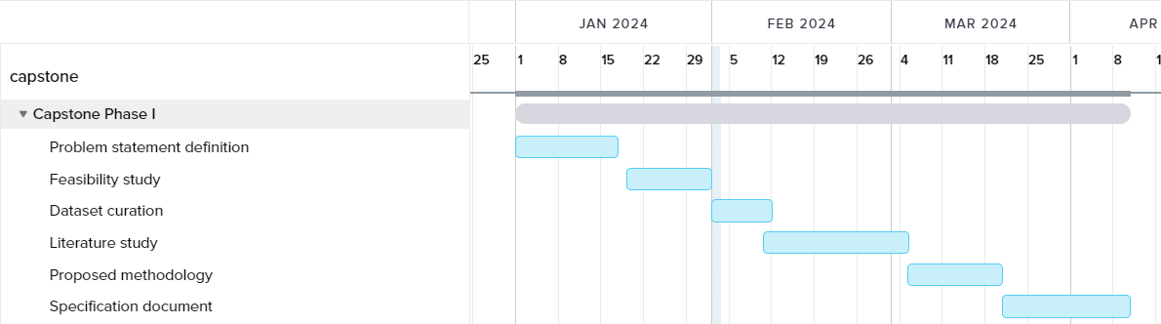

PROJECT TIMELINE
Phase 1
STRATEGY N°3

Slide 23
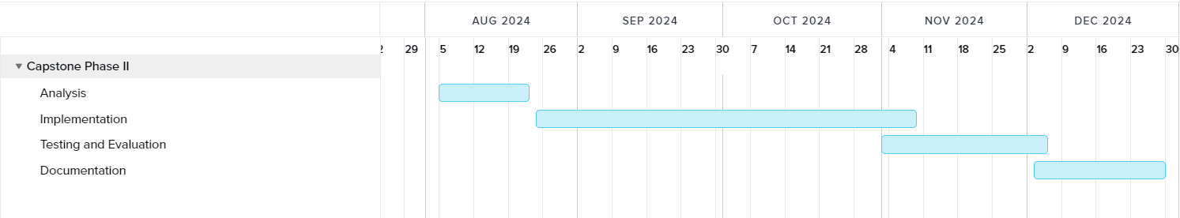
PROJECT TIMELINE
Phase 2
STRATEGY N°3

Slide 24
CONCLUSION
The toxicity detection web application aims to provide a reliable and scalable solution for identifying harmful content in social media.
Through robust security measures and user-friendly interfaces, the application ensures the privacy and safety of users' data.
High performance and usability are key priorities, allowing users to efficiently interact with the application and obtain accurate toxicity analysis results in real-time.
The application is designed with maintainability and portability in mind, enabling seamless updates and accessibility across different devices and platforms.
Overall, the toxicity detection web application strives to meet non-functional requirements while prioritizing user satisfaction and safety in online interactions.

Slide 25
REFERENCES
1] Pavlopoulos, J., Sorensen, J., Dixon, L., Thain, N., & Androutsopoulos, I. (2020). Toxicity detection: Does context really matter?. arXiv preprint arXiv:2006.00998.
Link :https://arxiv.org/abs/2006.00998
[2] Kurita, Keita, Anna Belova, and Antonios Anastasopoulos. "Towards robust toxic content classification." arXiv preprint arXiv:1912.06872 (2019).
Link : https://arxiv.org/abs/1912.06872
[3]K. S. Ashok, K. A. Ashok and S. M. B. Naseem, "A Neuro-NLP Induced Deep Learning Model Developed Towards Comment Based Toxicity Prediction," 2022 5th International Conference on Advances in Science and Technology (ICAST), Mumbai, India, 2022, pp. 94-99, doi: 10.1109/ICAST55766.2022.10039597.
Link : https://ieeexplore.ieee.org/document/10039597
[4]A. Garlapati, N. Malisetty and G. Narayanan, "Classification of Toxicity in Comments using NLP and LSTM," 2022 8th International Conference on Advanced Computing and Communication Systems (ICACCS), Coimbatore, India, 2022, pp. 16-21, doi: 10.1109/ICACCS54159.2022.9785067.
LInk : https://ieeexplore.ieee.org/document/9785067
[5]Betty van Aken, Julian Risch, Ralf Krestel, and Alexander L¨oser, arXiv:1809.07572 ,Challenges for Toxic Comment Classification: An In-Depth Error Analysis, 2018
Link: https://arxiv.org/abs/1809.07572
[6]João A. Leite, Diego F. Silva, Kalina Bontcheva, Carolina Scarton, arXiv:2010.04543 ,Toxic Language Detection in Social Media for Brazilian Portuguese: New Dataset and Multilingual Analysis, 2020
Link: https://arxiv.org/abs/2010.04543
[7] Aji, Fazjar Sekti, and Ade Iriani. "Toxicity and Sentiment Analysis About Digital Bounty on Social Media." 2023 12th International Conference on Awareness Science and Technology (iCAST). IEEE, 2023.
Link: https://ieeexplore.ieee.org/abstract/document/10359318
[8] Zhu, Wanzheng, et al. "Self-supervised euphemism detection and identification for content moderation." 2021 IEEE Symposium on Security and Privacy (SP). IEEE, 2021.
Link: https://ieeexplore.ieee.org/abstract/document/9519422

Slide 26
Thank You

